Slide 1

Heart Failure
Brian Lee, Zhu Jiawei,
Yeung Cho Ho, Leung Wing Shun

Slide 2
Presentation Flow
Solution of reading files
Slide 5-8
Read different data types
Problematic files
Merge dataset
Export dataset
Problem Description, Tabulation
Slide 3-4
Conditionals and Loops
(IF-ELSE + PROC SQL)
Slide 9-11
Data Visualisation
Slide 12-13
Conclusion, Limitation
Slide 18
One sample T-Test
Test for normality
Unpaired Two Sample T test
Wilcoxon Rank Sum Test
Box Plot
Regression Plot
Data Analysis
Slide 14-17
Notes:
Brian Lee, Jiawei Zhu

Slide 3
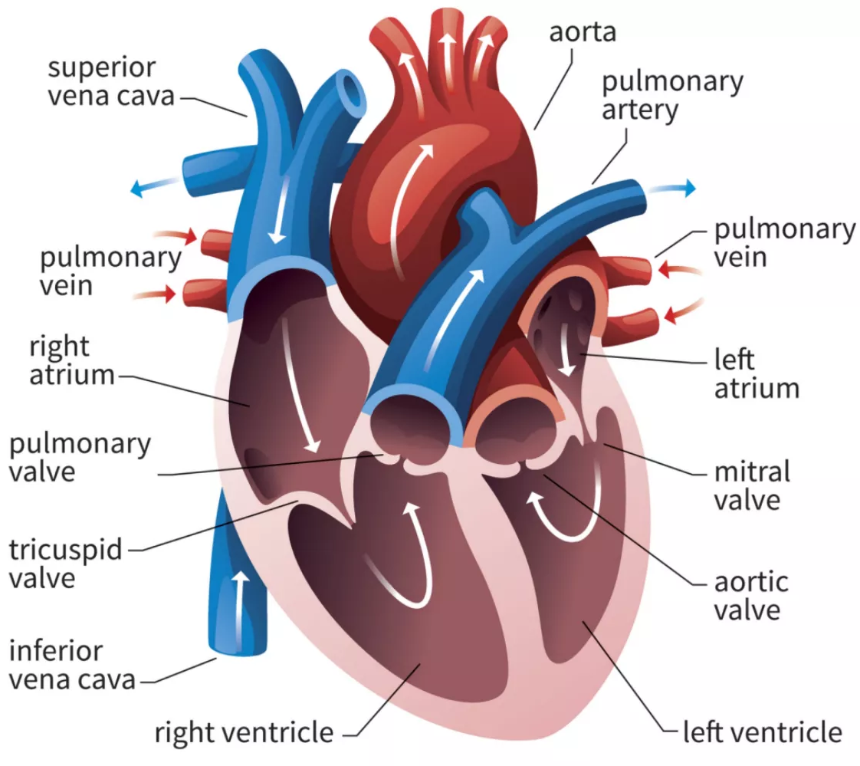
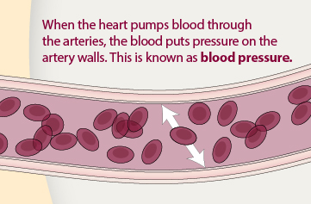
Problem Description, Research Objectives
Blood is pumped via arteries and veins → cardiovascular system
Atriums and ventricles → oxygenated blood → human body
Different causes can lead to heart disease
Congenital heart defects and arrhythmias
High blood pressure
decreases the flow of blood and oxygen to your heart
interrupting the flow of the blood cells.
Research objective:
Apply visualization and statistical analysis → factors that contribute to heart failure
Bailey (n.d.)
Centers for Disease Control and Prevention (n.d.)
Notes:
Brian Lee

Slide 4
Tabulation
Dataset imported from the “heart_failure_clinical_dataset” csv file with 299 records and read in SAS Program.
Dataset link: https://www.kaggle.com/datasets/andrewmvd/heart-failure-clinical-data
First 16 records of the dataset → extracted from the original csv file → dat file named “heartfailure” → for simplicity and ease in data processing
Shortened name of variables → easier for reading data in data implementation and analysis
Alpha values set as 0.05 for analysis and the threshold for rejection.
Notes:
Jiawei Zhu

Slide 5

Reading data in different data types
As data scientists, we might get the files in different format.
Sometimes, our customers will provide a txt note.
We provide the solutions for reading of different type of original datas.
Notes:
Jiawei Zhu

Slide 6
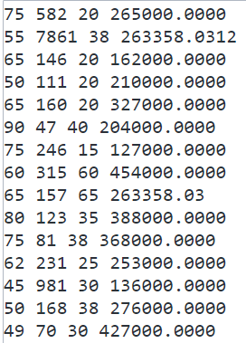
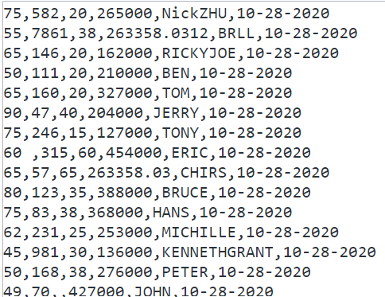
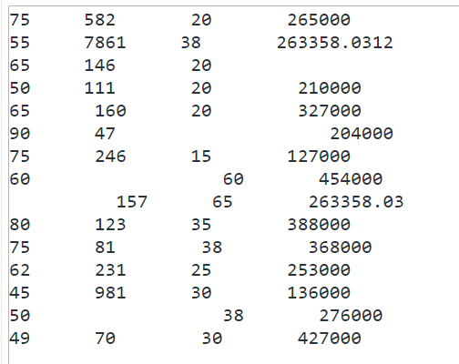
Problematic Files
Daily use → problematic files like overlength, missing value.
There also be any kind of values, e.g. the surgeon need to record the date of some essential events, the name of the patience, and the datas as parameter of the the patiences.
Notes:
Jiawei Zhu

Slide 7
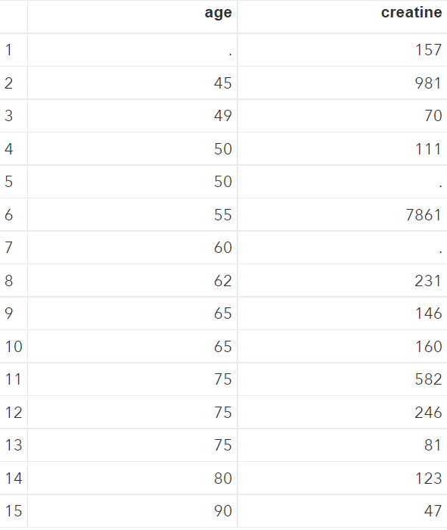
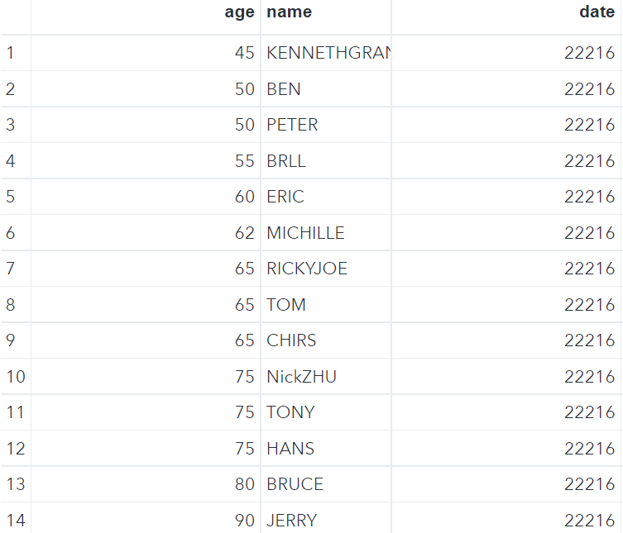
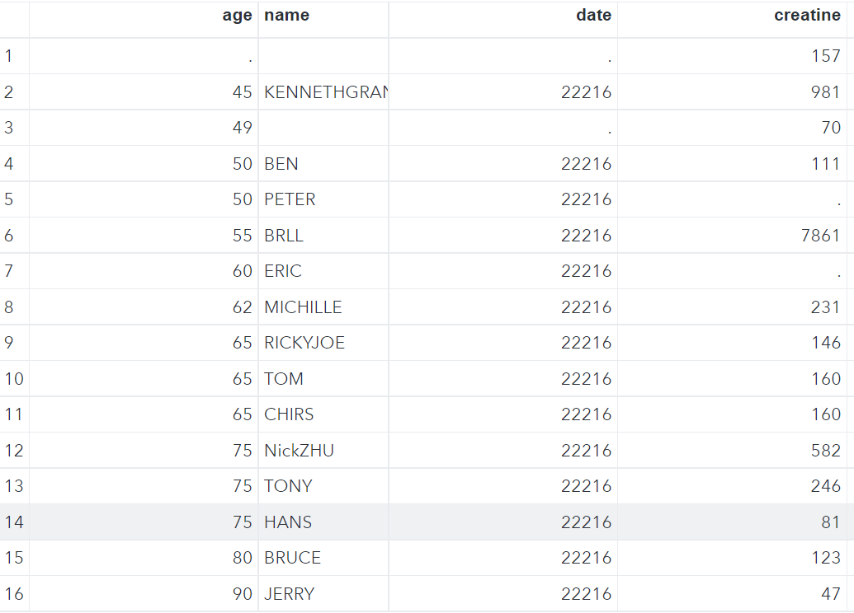
Merge Dataset
Data → may be separated in different files.
Abstract the datas we need to use.
MERGE the different tables by key variables.
When the customers need the dates in specified type. We also provided the solution for this request.
Notes:
Jiawei Zhu

Slide 8
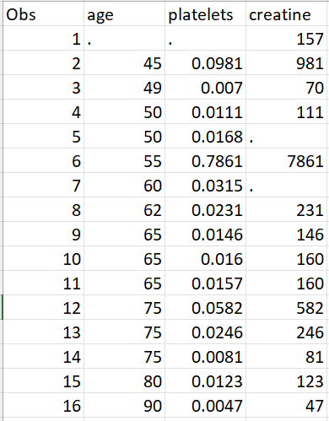
Export Dataset
Export the dataset into csv file as shown
in the figure on the right.
Notes:
Jiawei Zhu

Slide 9
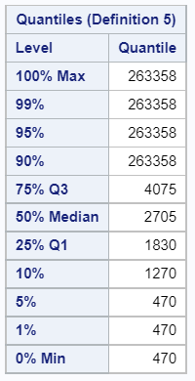
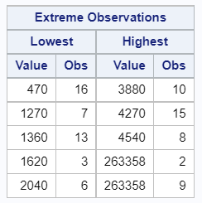
Extreme Observations and Statistics: PROC UNIVARIATE
4 extreme observations
Variable: platelets
50% people(1830-4075 ml platelets)
quartile deviation = 2245
4 maximum values: obs 2, 8, 9, 15
4 minimum values: obs 6, 7, 13, 16
Quantiles are identified.
Notes:
Yeung Cho Ho

Slide 10
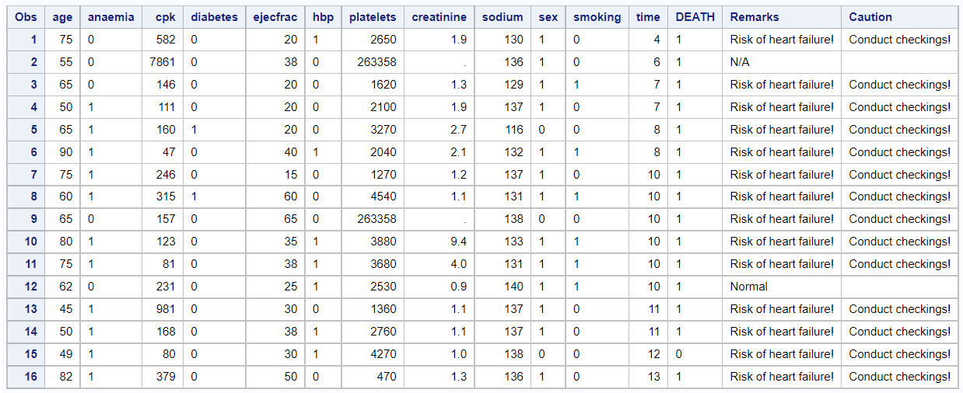
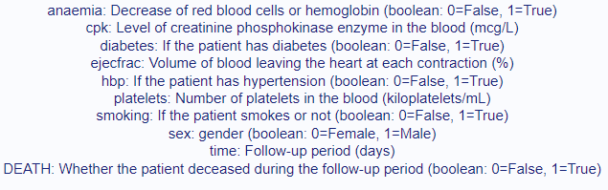
Conditionals and Loops with IF and DO statements
Loops through every condition and returns a value when the first condition is met.
True condition → jump directly to end of loop and returns result.
No conditions met → returns value in the ELSE clause.
If the result requires more than 2 steps → use DO
If missing data exists → return N/A for the two newly created variables
Used 2 IF-THEN-ELSE statements, with one of them with a DO statement
2 new variables: Remarks, Caution on the rightmost 2 columns
Notes:
Leung Wing Shun

Slide 11
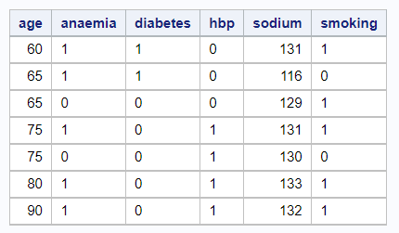
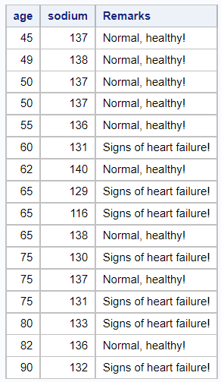
PROC SQL DML and CASE WHEN statements
FILTER CONDITIONS with NOT IN and subquery using data manipulation language
CASE WHEN statement: same logic to IF-THEN-ELSE IF statement
Loops through every condition and returns a value when the first condition is met.
True condition → stop reading, jump directly to end and returns result.
No conditions met → returns value in the ELSE clause.
No ELSE part and no true conditions → return NULL
Notes:
Brian Lee, Leung Wing Shun

Slide 12
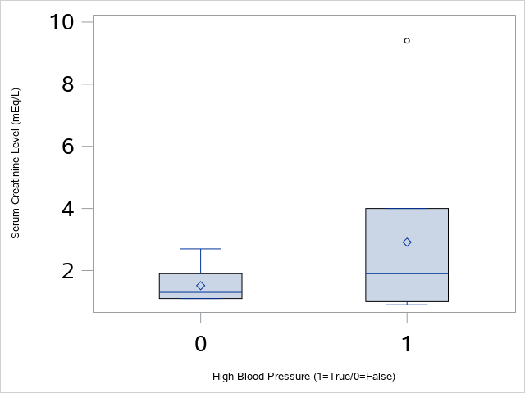
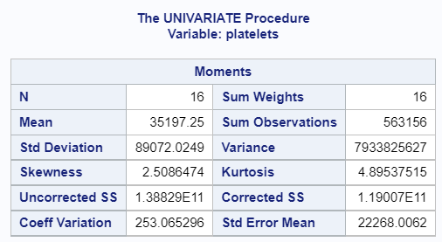
Box Plot
Extreme outliers → both groups of patients (Kurtosis = 4.8954)
Highly positively skewed (Skewness = 2.5086)
External factors
other long-term diseases
inherited genetic issue
Internal factors
inaccurate measurements and readings
errors in the practical labs
Notes:
Brian Lee

Slide 13
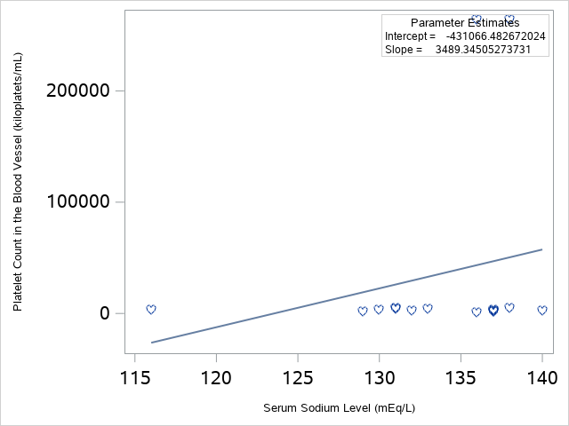
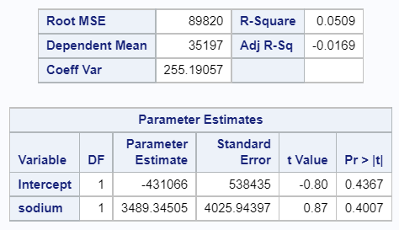
Regression Plot
R²=0.0509
Limited portions of platelets (y) can be explained by sodium (x).
No existence of linear relationship
Outliers → both groups of patients
External factors
other long-term diseases
inherited genetic issue
Internal factors
inaccurate measurements in sampling
errors in lab procedures
Notes:
Leung Wing Shun

Slide 14
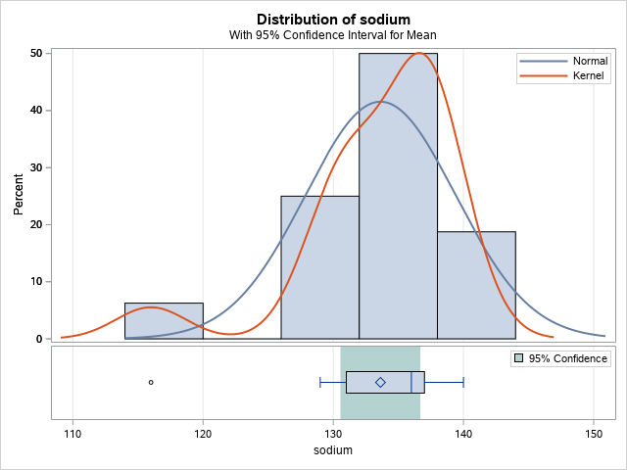
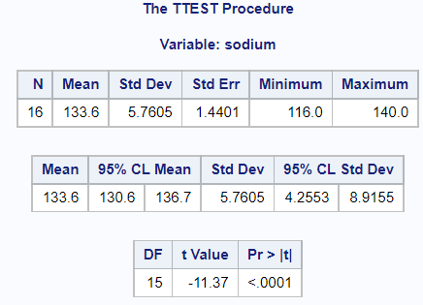
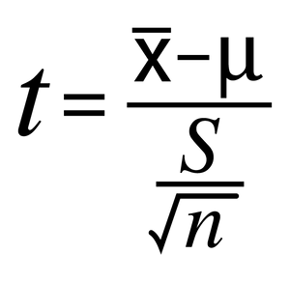
One Sample T Test
Whether a sample mean is the same as population mean from dataset values
Chosen variable: sodium
H0: mean=150 ←→ H1: not H0.
p < 0.05 (p < 0.0001)
The hypothesized sample mean is significantly different as population mean of dataset for the variable sodium.
Notes:
Yeung Cho Ho

Slide 15
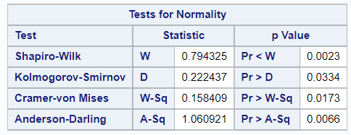

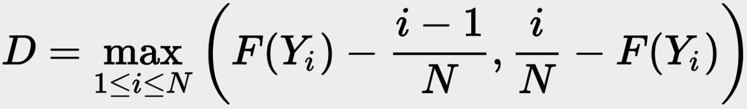
Normality Testing
Verify the normality of the data distribution from One Sample T-Test
Since sample size is small (n < 50) → use Shapiro-Wilk and Kolmogorov-Smirnov Test.
H0: data follows a normal distribution ←→ H1 = not H0
p = 0.0023 and 0.0334 < 0.05
Data is not normally distributed!
Notes:
Brian Lee

Slide 16
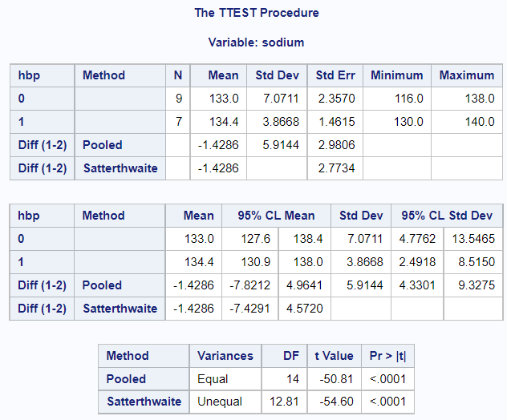
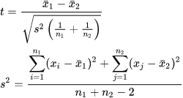
Two Sample Unpaired T Test
Whether the population mean is the significantly different between the two independent groups, assuming unequal variance between two groups.
Groups: patients with and without high blood pressure.
P value < 0.05 (p < 0.0001)
Reject null hypothesis
There is significant evidence that the
population mean is significantly different between
the two groups
Notes:
Brian Lee

Slide 17
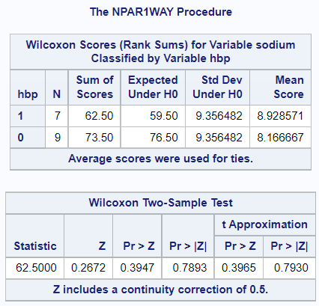
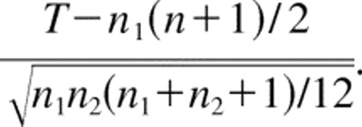
Wilcoxon Rank Sum Test for Independent Samples
Examines whether two independent groups
are significantly different in terms of the median
Two groups: patients with and without hbp
P value > 0.05 → do not reject null hypothesis
No evidence that the median is significantly
different between the two groups
Notes:
Brian Lee

Slide 18
Conclusion and Limitations
Conclusion
Extreme outliers from box and regression plots
Reasons of outliers: inaccurate measurement of blood, sampling error in lab trials
Help doctors and physicians to propose ways to enhance the diagnosis of heart failure.
Limitation and Suggestions
Other internal factors not considered, e.g. family genetic history
Extra information on standardization of sampling procedures
Extreme outliers should be replaced by the population mean of the variable
More trials and samplings needed
Outlier analysis
Notes:
Leung Wing Shun
Outliers identified from visualisation
Helps doctors and physicians to improve the diagnosis of heart failure
Internal factors should be taken into account
More trials, samplings, outlier analysis required

Slide 19
Reference
Stöppler, M. C. (n.d.). Heart disease: Symptoms, signs, causes and treatment. MedicineNet. https://www.medicinenet.com/heart_disease_symptoms_and_signs/symptoms.htm
Bailey, R. (n.d.). Functions of the Heart. ThoughtCo. https://www.thoughtco.com/ventricles-of-the-heart-373254
Centers for Disease Control and Prevention. (n.d.). High blood pressure symptoms and causes. Centers for Disease Control and Prevention. https://www.cdc.gov/bloodpressure/about.htm#:~:text=High%20blood%20pressure%20can%20damage%20your%20arteries%20by%20making%20them,Chest%20pain%2C%20also%20called%20angina
Wicklin, D. (2013). How to use PROC SGPLOT to display the slope and intercept of a regression line. SAS Blogs. https://blogs.sas.com/content/iml/2013/02/27/slope-of-a-regression-line.html

Slide 20
Role List
 | Brian Lee | Zhu Jiawei | Yeung Cho Ho | Leung Wing Shun
Problem Description, Research Objective
Reading data in different data types
Problematic Files
Merge Dataset
Export Dataset
Extreme Observations
Conditionals and Loops (IF-THEN, DO + PROC SQL)
Box Plot
Regression Plot
One Sample T Test
Test for Normality
Two Sample Unpaired T Test
Wilcoxon Rank Sum Test for Independent Samples
Conclusion and Limitation

